Slide 1
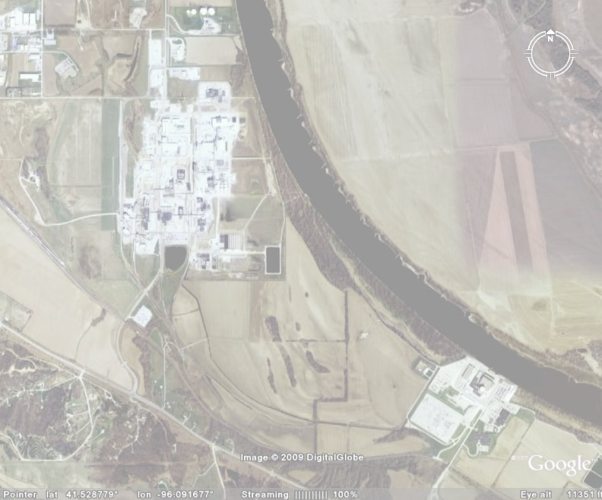
Bioprocessing - A Brief Introduction
Michael P. Rouse
Middough, Inc.
February 10, 2009

Slide 2
Bioprocessing:
The Integrated Biorefinery

Slide 3
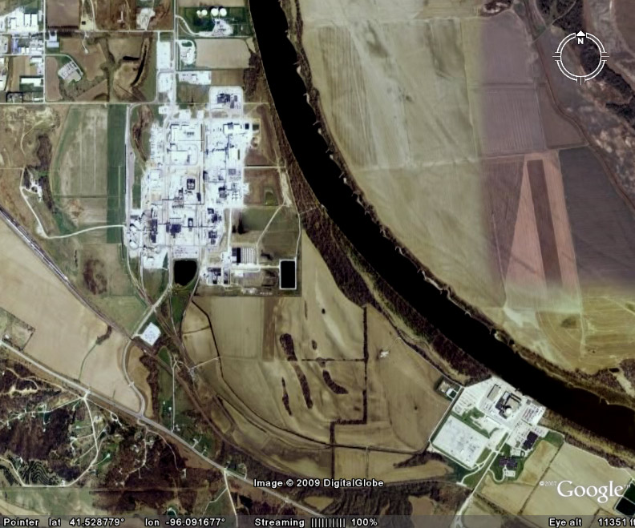
The
Future?
Solid Fuel (Biomass)
+ Electricity
↓
Liquid Fuel (Ethanol)
+ Biochemicals
Cargill
Biorefinery
Complex
Solid Fuel
(Uranium)
↓
Electricity
Fort Calhoun
Nuclear Power Plant

Slide 4
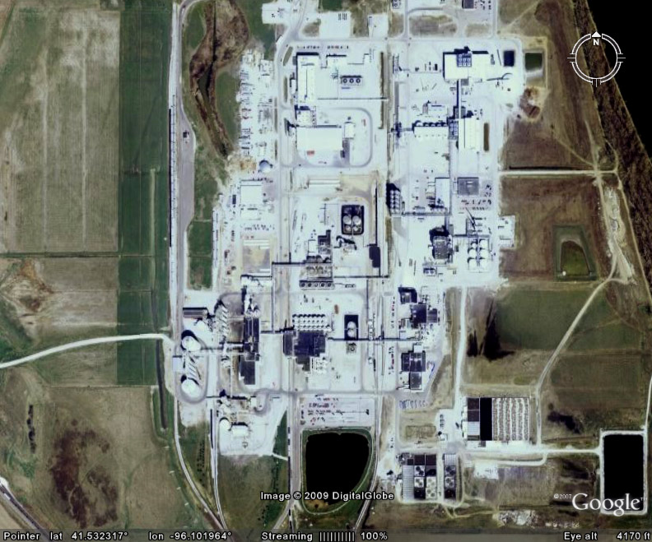
Products
Corn
Receiving
Polyols
Amino
Acids
Ethanol
Steeping
Polylactic
Acid
Milling
Refining
Lactic
Acid
Animal
Feed
Corn
Syrups
Enzymes
(Future)
Corn Oil
Notes:
4

Slide 5
Bioprocesses
Amino Acids
Enzymes
Lactic Acid
Ethanol
Corn Steeping
Saccharification
Starch Liquefaction
Glucose Isomerization
Anaerobic Biodegradation
Aerobic Biodegradation

Slide 6
Bioprocessing: The Basics

Slide 7
Bioprocess Mechanisms
Live whole cell: used for energy-requiring processes and biodegradation
Dead whole cell: typically used to immobilize enzymes (not common)
Cell-free enzymes: used as homogeneous catalysts - typically hydrolases

Slide 8
Bioprocess Organisms
Unicellular: bacteria, cyanobacteria, algae, yeast, mammalian cells, plant cells, insect cells
Filamentous: fungi
“Higher life forms”: plants, animals - biopharming

Slide 9
February 7, 2009
F.D.A. Approves Drug From Gene-Altered Goats
By ANDREW POLLACK
Opening the barn door to a new era in farming and pharmaceuticals, the Food and Drug Administration on Friday approved the first drug produced by livestock that have been given a human gene.
The drug, meant to prevent fatal blood clots in people with a rare condition, is a human protein extracted from the milk of genetically engineered goats.
At the same time, the F.D.A. also approved the goats used to make the drug, the first such animals cleared under guidelines the agency adopted only last month to regulate the use of transgenic animals in the nation’s drug and food supply.
Made by a company called GTC Biotherapeutics, the human anticlotting protein is produced by a herd of 200 bioengineered goats living under carefully controlled conditions on a farm in central Massachusetts.

Slide 10
Bioprocess Classes
Biosynthesis: Products synthesized by anabolic or catabolic pathways
Biotransformation: Starting compound transformed into new compound via one or more enzymatic reactions
Biodegradation: Feedstocks catabolized into simple, often inorganic, compounds

Slide 11
Bioprocessing:
Some Examples

Slide 12
Biosynthetic Processes
Primary Metabolites – Live cell processes generally linked to growth:
  Ethanol from glucose:
  C₆H₁₂O₆ → 2C₂H₅OH + 2CO₂ + Energy
  Biogas from cellulose:
  [C₆H₁₀O₅]_{n} + nH₂O → 3nCH₄ + 3nCO₂ + Energy
  Lactic acid from glucose:
  C₆H₁₂O₆ → 2C₂H₄OHCOOH + Energy

Slide 13
Biosynthetic Processes
Lactic acid from glucose - pyruvic acid as an electron acceptor/reducing equivalents sink:
  Glycolysis:
  C₆H₁₂O₆ + 2NAD⁺ + 2ADP + 2P_{i} → → → →
  2C₂H₃OCOOH + 2NADH + 2H⁺ + 2ATP + 2H₂O
  NAD⁺ Regeneration:
  2C₂H₃OCOOH+ 2NADH + 2H⁺ →
  2C₂H₄OHCOOH+ 2NAD⁺

Slide 14
Biosynthetic Processes
Secondary metabolites - live cell processes independent of growth:
  Antibiotics: penicillin, erythromycin
  Amino acids: lysine, tryptophan
  Fatty acids: arachidonic acid, docosahexaenoic acid

Slide 15
Biosynthetic Processes
Secondary metabolites - continued:
  Triglycerides: algae biodiesel
  Polyhydroxyalkanoates: natural polyesters
  Therapeutic proteins: insulin, EPO, “clot busters”, monoclonal antibodies
  Industrial enzymes: amylases, proteases, lipases, cellulases

Slide 16
Biotransformation Processes
Live whole-cell processes:
  Acetic acid from ethanol:
  C₂H₅OH + O₂ → CH₃COOH + H₂O + Energy
  Diesel biodesulfurization:
+ 3O₂ + 4NADH + 4H⁺→
S
HO
+ 4NAD⁺ + 3H₂O
SO₂⁻ H⁺

Slide 17
Biotransformation Processes
C
CH
+ O₂ + NADH + H⁺→
C
CH
+ NAD⁺
HO
OH
BASE
→
C
CH
C
CH
+ H₂O
HO
OH
HO
Live whole-cell processes:
  meta-hydroxyphenylacetylene:

Slide 18
Biotransformation Processes
Dead whole-cell processes:
  Glucose isomerase:
  glucose fructose (HFCS)
Enzyme (cell-free) processes:
  Starch liquefaction
  Saccharification
  Cellulose hydrolysis

Slide 19

Biotransformation Processes
Enzyme (cell-free) processes:
  Laundry stain removal
  Bread staling inhibition
  Lipid hydrolysis
  Transesterification – improvement in vegetable oil properties, conversion of triglycerides to fatty acid methyl esters.

Slide 20
Bioprocessing:
Understanding The Limitations

Slide 21
Technical Limitations
Biological contamination:
  Difficult to exclude all other microorganisms, phages
  An area not well understood and appreciated by non bioprocess engineers
  Limits most biosynthesis and biotransformation processes to batch

Slide 22
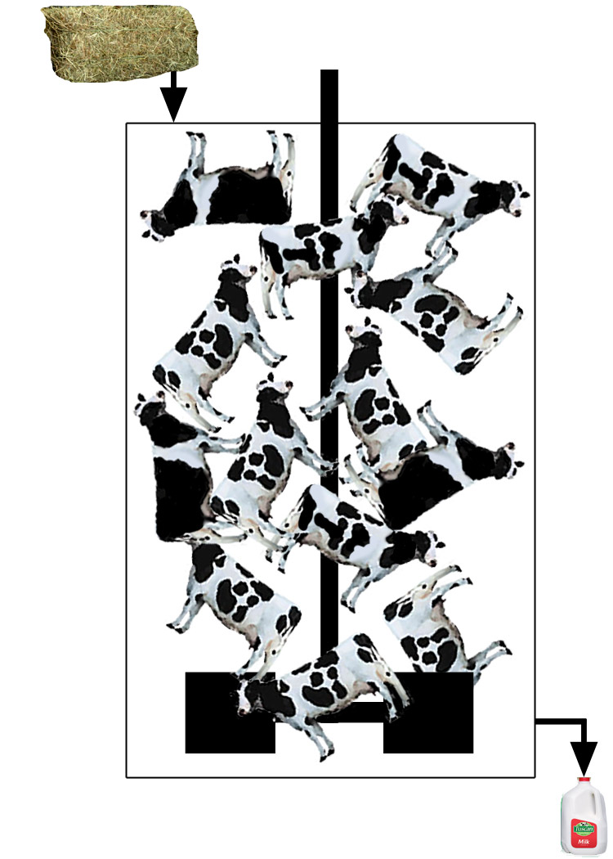
A Chemical Engineer’s Approach to Milk Production

Slide 23
Technical Limitations
“Catalyst” is a living organism:
  Easy to kill/inactivate by process upsets
  Slow to grow
  Works only in a narrow range of temperature, pressure, pH, oxygen concentration, etc.
  Shear-sensitive

Slide 24
Undergraduate research ethanol production
First job ethanol research
Ethanol plant engineering
The Life of a Bioprocess Engineer
High school senior
project biogas production
Higher value bioproducts
Born
Laid off
Midlife Crisis
Source: http://www.inflationdata.com/inflation/Inflation_Rate/Historical_Oil_Prices_Table.asp accessed February 10, 2009

Slide 25
What’s the Point?

Slide 26
Economic Reality
High capital costs:
  Slow growing/ dilute aqueous batch processes require large/multiple reactors
  Aqueous reaction media require 304/316 stainless steel equipment and piping
  Large, multiple step downstream processing to recover product from dilute aqueous reaction media

Slide 27
Economic Reality
High operating costs:
  Cells can require expensive media to grow
  Aerobic processes require considerable electric power input for aeration
  Processes require skilled labor 24/7 to operate
  Multiple downstream steps required to recover products from dilute streams

Slide 28
When to Use Bioprocesses
Chiral compounds: amino, lactic acids
Complex, high-value organic molecules: citric acid, antibiotics, proteins
Highly specific reactions: Starch/ cellulose hydrolysis, hydroxylations
Biodegradation of waste streams: sewage, animal manures

Slide 29
When Not to Use Bioprocesses
Low value, high volume simple molecules: BTX, ethylene, alcohols
Fuels: ethanol, butanol, diesel
Toxic compounds: phenols

Slide 30
When to Consider Bioprocesses
Here
Here
Source: http://www.inflationdata.com/inflation/Inflation_Rate/Historical_Oil_Prices_Table.asp accessed February 10, 2009

Slide 31
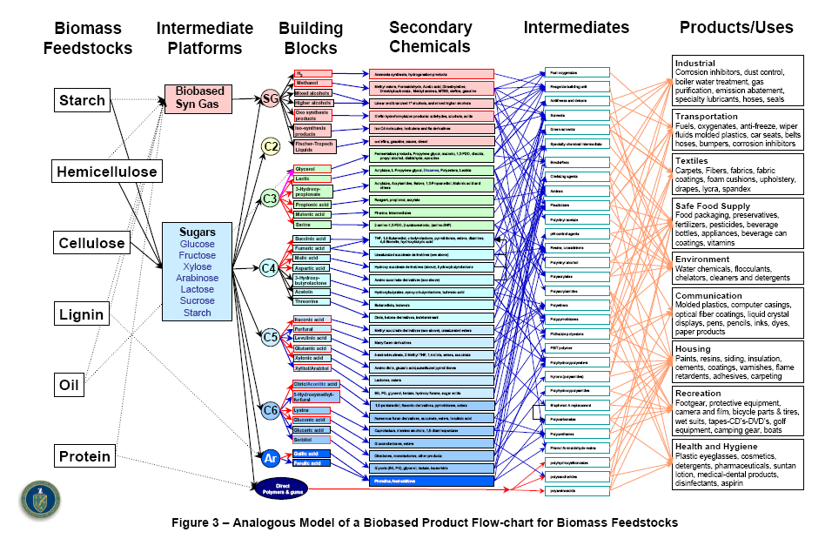
Source: Top Value Added Chemicals from Biomass Volume I—Results of Screening for Potential Candidates from Sugars and Synthesis Gas, T. Werpy and G. Petersen, Editors, Pacific Northwest National Laboratory (PNNL) and National Renewable Energy Laboratory (NREL), 2004

Slide 32
In Summary
Bioprocesses have been and will continue to be important for the production of foods and medicines
Bioprocesses have an uncertain future in the production of fuels
Bioprocesses are likely to become more important in the production of fine and commodity chemicals

